Slide 1

HOSPITAL MANAGEMENT SYSTEM
Guided by: Mr. Anuj Kumar Sir​

Slide 2

Introduction
Hospital Management System provides the benefits of enhanced administration and control, superior patient care, strict cost control and improved profitability.
HMS is strong, powerful and easy to use and is designed and developed to deliver real conceivable benefits to hospitals.

Slide 3
PRIMARY GOALS
Design a system for better patient care
Reduce hospital operating cost.
Facilitate easy scheduling of appointments for patients, Facilitate easy scheduling of appointments for patients, doctors to minimize waiting time
Better co-ordination among different departments
The information of the patients should be kept up to date for historical purposes

Slide 4
Need of HMS
Streamlined Operations: Hospitals deal with numerous administrative tasks, such as appointment scheduling, patient registration, billing, and inventory management. An HMS automates these processes, streamlining operations and reducing manual paperwork, thus improving efficiency.
An HMS enables healthcare providers to access patient medical records, treatment histories, and diagnostic reports efficiently. This facilitates informed decision-making, accurate diagnosis, and personalized treatment plans, ultimately leading to better patient care and outcomes.
Improved Resource Utilization: Hospital resources, including medical equipment, beds, and staff, need to be managed effectively to ensure optimal utilization. An HMS helps in resource allocation, scheduling, and tracking, minimizing wastage and ensuring that resources are utilized efficiently.
Remote Access and Telemedicine: With the rise of telemedicine and remote healthcare services, an HMS facilitates remote access to patient records, virtual consultations, and telehealth services. Healthcare providers can securely access patient information from anywhere, enabling continuity of care and improving accessibility for patients.

Slide 5

Proposed System
It controls the following information:
1). Appointment System
2). Doctor Availability
3). Check-up status
4). Admin accessibility
5). Medication history

Slide 6



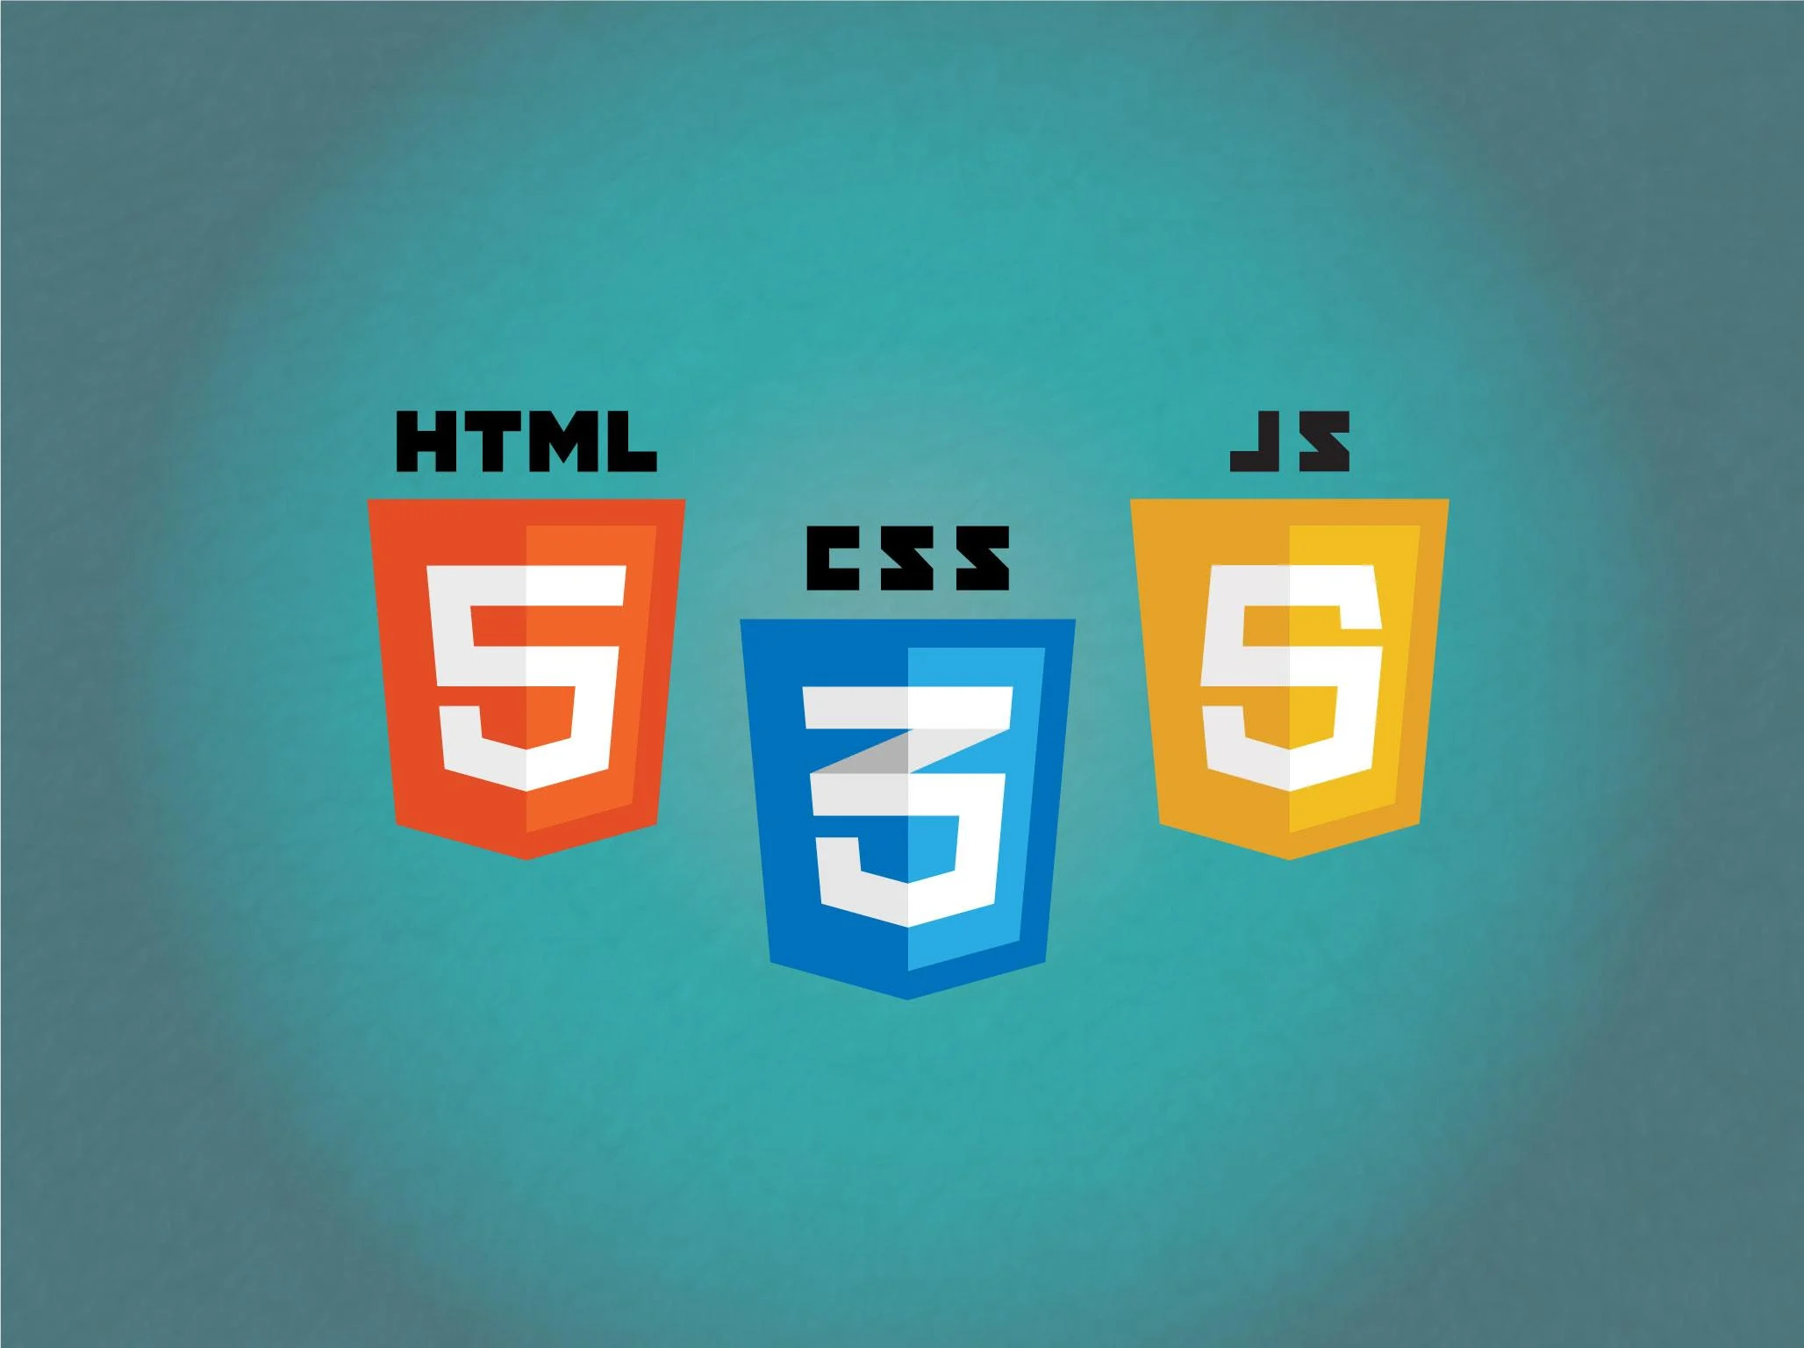
Technologies Used
HTML, CSS, JAVASCRIPT, BOOTSTRAP
JAVA
MYSQL

Slide 7
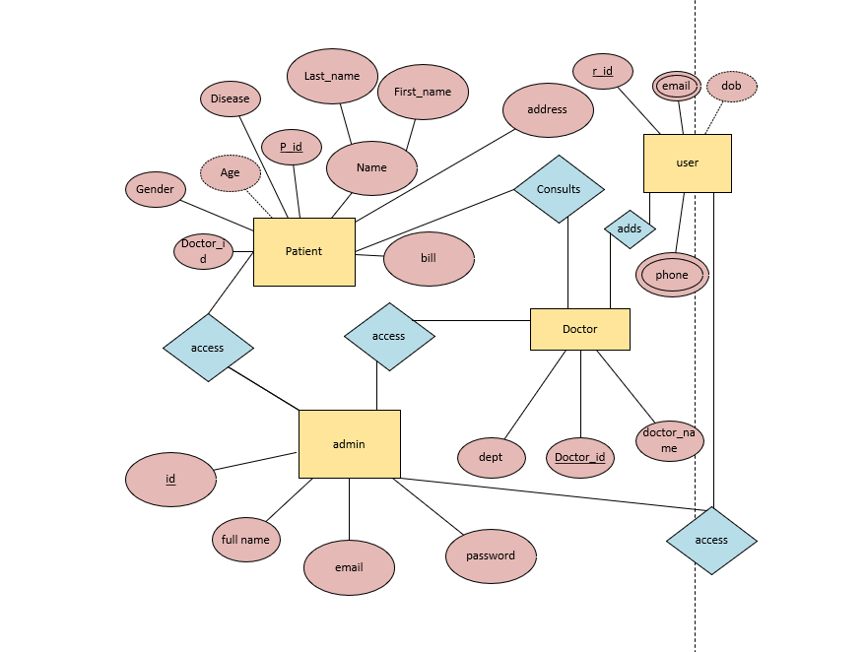
ER DIAGRAM

Slide 8
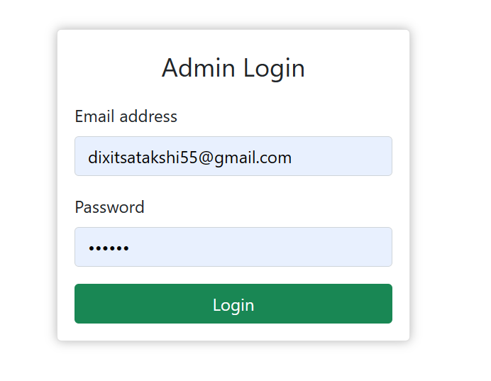
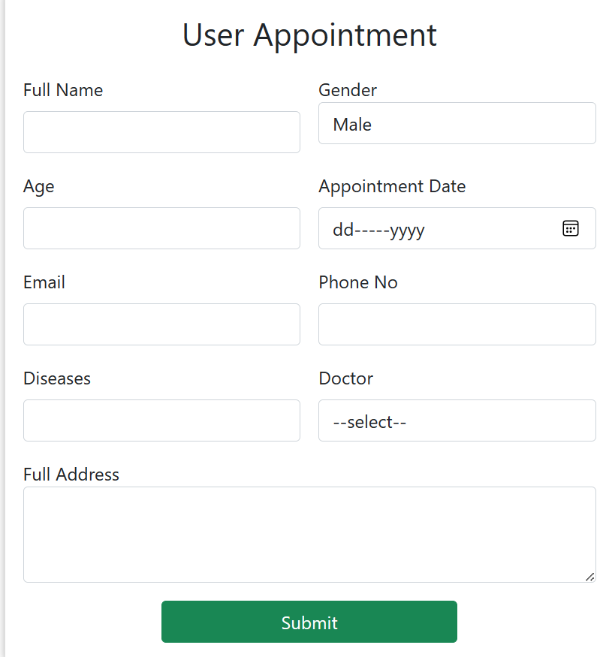
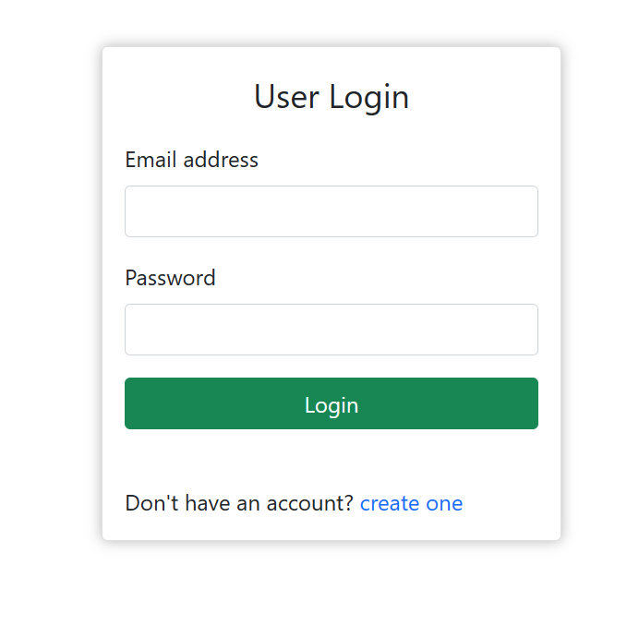
Glimpse of our Website

Slide 9
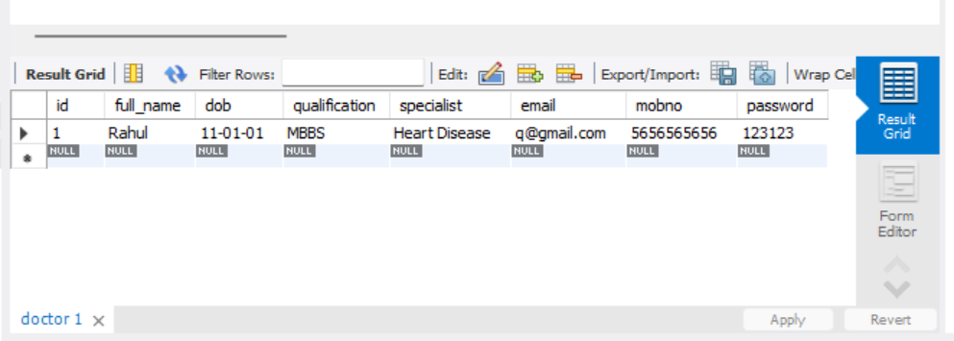
Storing Data in MySQL

Slide 10
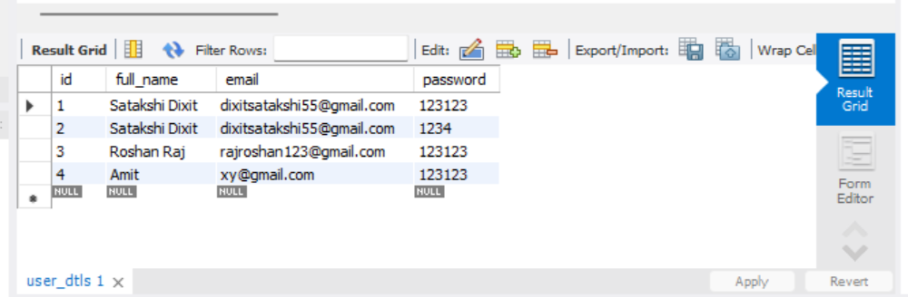
User Details

Slide 11
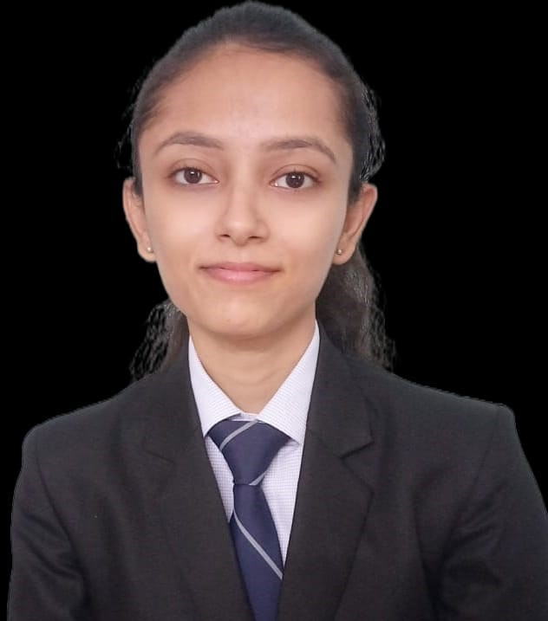

Team Members
Satakshi Dixit(CS- AIML)
Roshan Raj(CS- IOT)

Slide 12
Thank you

